Slide 1


How to be a good ghost spotter – basic accessibility testing
Notes:
Welcome everyone to the session. Today we’re going to learn basic accessibility testing in a fun way. The theme is “How to be a good ghost spotter” – we’ll treat accessibility issues like ghosts hiding in a service. This is an introduction to quick checks, not a full audit. The goal is to help you spot common accessibility problems and understand why they matter. By the end, you’ll feel more confident doing simple checks before handing work over for a full review.

Slide 2

Record a ghost sighting
Welcome to the Department for Supernatural Affairs service to ‘Record a ghost sighting’ (password = Halloween).
This spooky service contains intentional accessibility issues — your job is to find them all and get your special “Ghost spotter’s” badge.
Some might be tricker than others.
Each page contains one or more accessibility issues (and perhaps a lurking ghost 👻), some might be tricker than others to find.
Notes:
This exercise is called “Record a ghost sighting”. The idea is to make accessibility testing engaging by using a spooky theme. The service is intentionally designed with accessibility issues for participants to find. Each page may have one or more issues, and some will be harder to spot than others. The goal is to identify all issues and earn the “Ghost spotter’s badge”. This activity helps participants understand how accessibility problems impact users and encourages quick checks at an early stage prior to completing full audits.

Slide 3
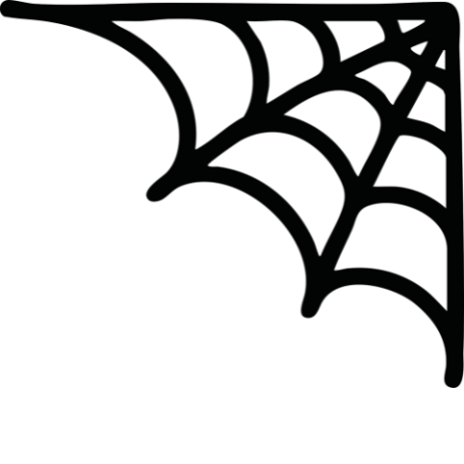
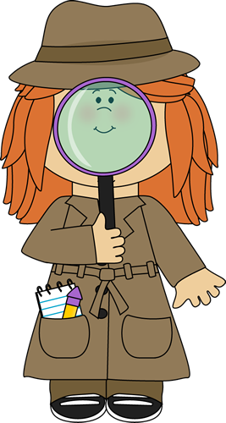
Ghost spotting skills
This is level of testing is not an audit or enough to be classed as full accessibility testing.
The training has been designed to help highlight how accessibility issues can affect users and could be used to conduct very quick checks.
Notes:
It’s important to stress that this is not a full accessibility audit. The checks we’ll cover are basic and quick, designed to help you spot common issues early. These quick checks can highlight how accessibility problems affect real users. They’re useful for designers, developers, and anyone who wants to improve accessibility before a formal review. Think of this as a practical introduction to accessibility awareness rather than compliance testing.

Slide 4

How to spot ghosts (accessibility issues)
To help find the issues, we are going to use the WAVE accessibility plugin
We’ll also complete the exercise using just a keyboard.
You could also use other automated or manual tools, including code inspection or assistive technology to help you if you know how as an extra activity.
Notes:
We’ll use the WAVE accessibility plugin as our main tool. WAVE gives a quick automated check, but remember it only finds some issues. We’ll also do keyboard-only testing to check navigation without a mouse. If you have extra skills, you can try other methods like: Inspecting the code
Using assistive technology
The goal is to show how different approaches reveal different problems.

Slide 5
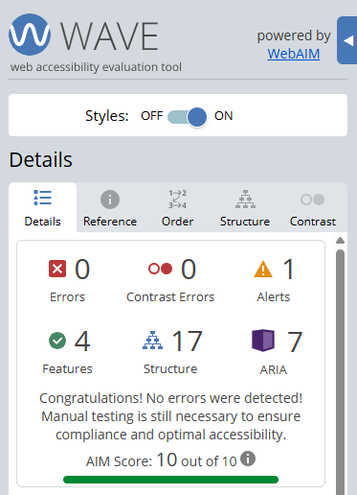

WAVE
WAVE is an automated accessibility checking tool
These tools are handy but only detect around 20-30% of accessibility issues
Useful to get a quick idea of accessibility ahead of full manual checks.
Notes:
WAVE, is an automated accessibility checking tool., there are lots of different automated testing tools so you could use whichever you find easiest.
WAVE is useful for quick checks but remember: It only detects about 20–30% of accessibility issues.
Automated tools can’t replace manual testing.
Use WAVE to get an initial idea of accessibility before doing deeper checks. It’s a good starting point for spotting obvious problems like missing alt text or contrast issues. After WAVE, we’ll combine this with keyboard testing for a more complete picture
The Details tab in WAVE provides a comprehensive list of all detected accessibility issues on the page. It breaks down errors, alerts, and features into categories such as:
Errors – Critical issues that fail WCAG standards (for example, missing alt text, empty links).
Alerts – Potential problems that need manual review (for example, suspicious heading structure).
Features – Accessibility elements present (for example, ARIA landmarks, headings).
Structural Elements – Lists, headings, and regions that define page hierarchy.
Contrast Issues – Low colour contrast warnings.
This tab is useful because it gives you a quick overview of what needs fixing and what is already implemented correctly. It’s a starting point for prioritising fixes before deeper manual testing.

Slide 6
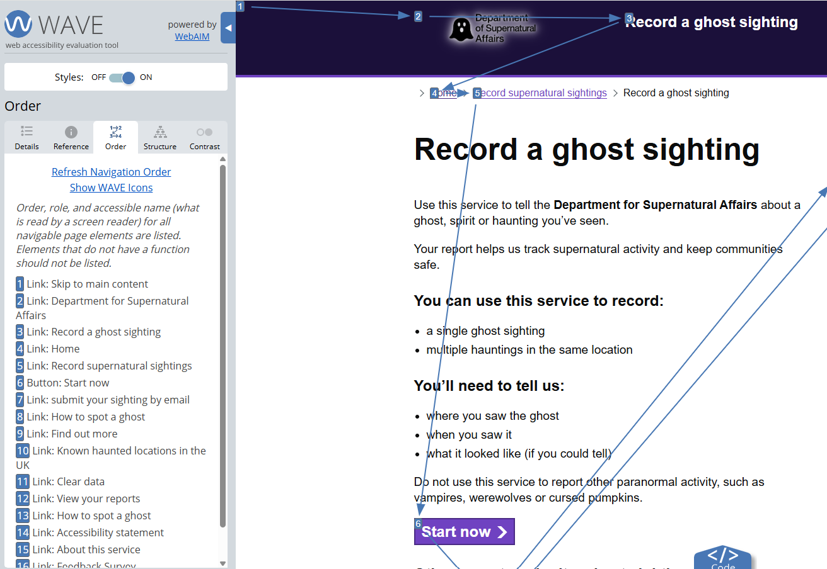

WAVE Order tab
Notes:
The Order tab shows the reading and navigation order of elements on the page. This is critical for: Screen reader users, who rely on logical reading order.
Keyboard users, who need predictable tab order.
If the order is incorrect, users can get lost or miss important content. When reviewing the Order tab: Check that headings, form fields, and interactive elements follow a logical sequence.
Make sure the visual layout matches the reading order.
This is one of the most important checks for usability and accessibility.

Slide 7
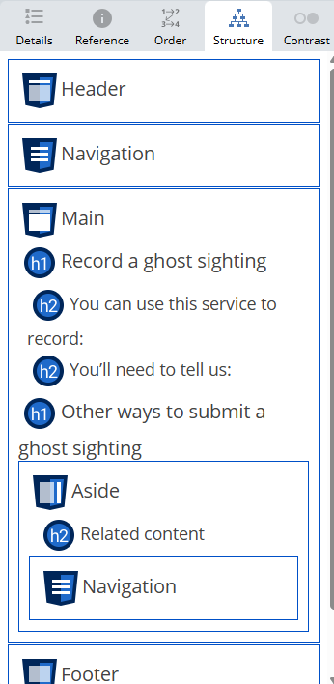
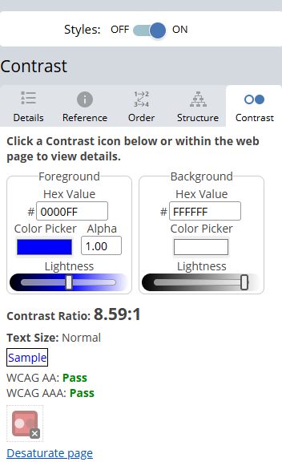

WAVE structure and contrast tabs
Notes:
This slide highlights two important WAVE tabs: Structure and Contrast. Structure tab: Shows headings, landmarks, and regions.
Helps check if the content hierarchy is logical and consistent.
Good structure supports screen reader navigation and improves usability.
Contrast tab: Checks colour contrast between text and background.
Low contrast makes text hard to read for people with visual impairments.
WCAG requires a minimum contrast ratio of 4.5:1 for normal text and 3:1 for large text.
Tip: Turn styles off: WAVE lets you disable CSS styles.
This is useful because it shows the raw HTML structure without visual design.
It helps confirm if headings, landmarks, and reading order make sense without relying on styling.
If the page becomes confusing without styles, it may indicate poor semantic structure.

Slide 8

Keyboard testing
Start in the browser address bar
Take your hand off the mouse and only use your keyboard (not the mouse pad on laptop).
Using the Tab button, navigate through the page
Use arrow keys, space and enter to work through the service.
Notes:
This slide introduces keyboard-only testing, which is essential for accessibility. Why it matters: Many users rely on keyboards instead of a mouse, including screen reader users and people with motor impairments. This is only very basic keyboard testing that we’ll go through today, there are many more different commands that can be used.
How to start: Begin in the browser address bar.
Take your hand off the mouse (and trackpad).
Use the Tab key to move through interactive elements: Links, buttons, form fields.
Use arrow keys, space, and enter to interact: Navigate menus, select options, activate controls.
The goal is to check: Can you reach all interactive elements?
Is the focus visible and logical?
Can you complete tasks without a mouse?
If something is hard or impossible to do with a keyboard, it’s an accessibility issue.

Slide 9

Keyboard commands
Key | Action
Tab | Go to next focusable item
Shift-tab | Go to previous focusable item
Arrow keys | Scroll the page, move between list items, tabs, radio buttons
Space | Open dropdown, check/uncheck checkbox, page down
Enter | Select item in dropdown, “click”
Esc | Close dialog, cancel a prompt
Command+L / Ctrl+L | Go to address bar
Notes:
This slide lists common keyboard commands for accessibility testing.
Why this matters:
Many users rely on keyboards, so everything must be operable without a mouse.
Key commands to remember:
Tab – Move to the next focusable element.
Shift + Tab – Move to the previous element.
Arrow keys – Scroll the page or move between items like lists, tabs, and radio buttons.
Space – Open dropdowns, check/uncheck checkboxes, or scroll down.
Enter – Activate links, buttons, or select items in dropdowns.
Esc – Close dialogs or cancel prompts.
Command + L / Ctrl + L – Jump to the address bar.
When testing:
Check if all interactive elements are reachable.
Ensure focus indicators are visible.
Confirm that actions work as expected without a mouse.
If any of these fail, it’s an accessibility issue.

Slide 10
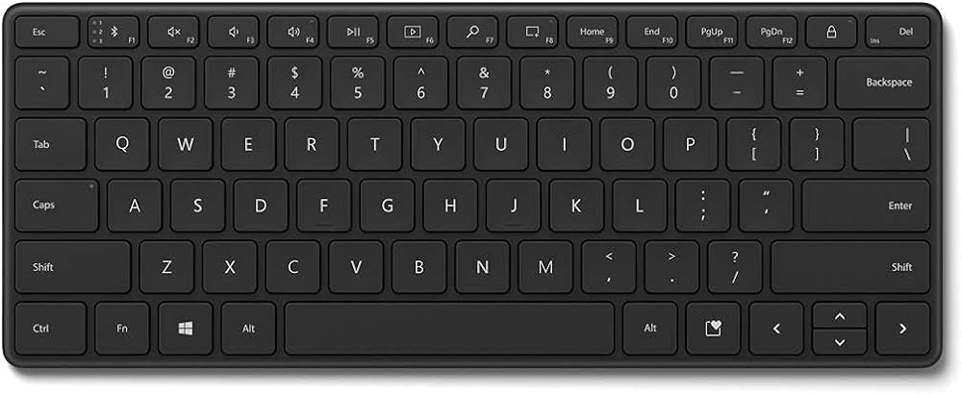
Windows keyboard
Close/cancel dialog
Go to next focusable element
Submit form/click link/press button/ confirm
Open a list/check a checkbox
Scroll page / move between list items
Notes:
This slide covers keyboard actions on Windows. These commands are essential for testing accessibility without a mouse. Key actions include: Close or cancel dialogs – usually with Esc.
Move to next focusable element – Tab.
Open lists or check checkboxes – Space.
Submit forms, click links, press buttons – Enter.
Scroll pages or move between list items – Arrow keys.
When testing: Check if these actions work consistently across the service.
If any fail, it’s an accessibility issue.

Slide 11
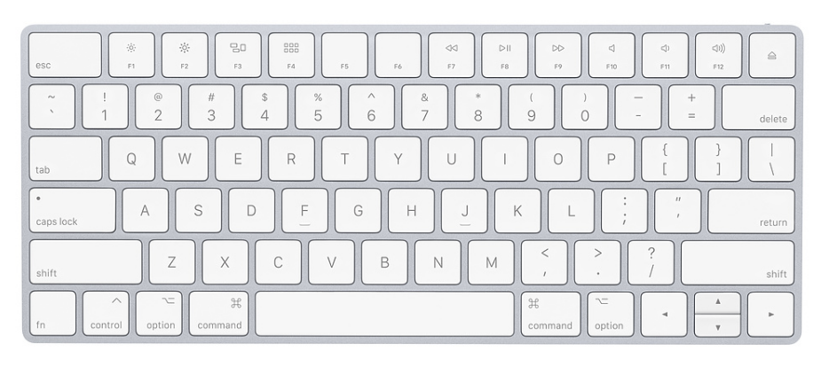
Apple keyboard
Close/cancel dialog
Submit form/click link/press button/ confirm
Go to next focusable element
Open a list/check a checkbox
Scroll page / move between list items
Notes:
This slide covers keyboard actions on macOS. The principles are the same as Windows, but shortcuts may differ slightly. Key actions include: Close or cancel dialogs – Esc.
Move to next focusable element – Tab.
Open lists or check checkboxes – Space.
Submit forms, click links, press buttons – Enter.
Scroll pages or move between list items – Arrow keys.
On macOS, ensure full keyboard access is enabled in system settings for proper testing. Again, if any of these fail, it’s an accessibility issue.

Slide 12
About this exercise
Accessibility training resource created by Lori Thomson, inspired by ‘Record a goose sighting’ exercise.
Built with an adapted GOV.UK Prototype Kit
Designed for workshops, self-led learning, and team exercises.
Each page fails one or more WCAG 2.2 AA criteria to encourage testing and discussion.
Explore or contribute on GitHub and share feedback
Thanks to the cross-government accessibility community for inspiration
Notes:
The “Record a ghost sighting” training prototype was created by Lori Thomson to make learning accessibility testing fun and memorable. Each page in the prototype contains intentional accessibility issues for learners to identify, test, and discuss. The exercise was inspired by Beverley Newing’s “Record a goose sighting” and uses an adapted GOV.UK Prototype Kit with a haunted twist. The goal is to help people understand accessibility barriers like colour contrast, keyboard navigation, and focus order. It’s designed for workshops, self-led learning, and team exercises, and every page fails one or more WCAG 2.2 AA criteria. Learners are encouraged to use different tools and assistive technologies and discuss the impact on real users. Contributions are welcome — you can explore or contribute on GitHub, share feedback by email, or complete the feedback survey.

